Slide 1

NOWADAYS
Late June 2023

Slide 2
news
It has been about 16 months since the Russian invasion began in Ukraine. Going back to January 2022, things looked very different worldwide. Nations were still recovering from the Covid-19 pandemic, but economies and stability levels were in a stronger position. These past few days, every news headline, no matter the country, is talking about it again.
Something almost all of us have been thinking about since March 2022 is the inflation situation. The Ukrainian war is among other factors (we could discuss them some other time) that have brought us to this scenario. However, it can be considered an X-factor when it comes to timing. The invasion began on Feb. 24th, 2022, even though if you read the right news, we knew about it a few weeks earlier.
Economy-wise, a tsunami happened. Commerce with natural gas, oil, grains... some areas where Russia has a huge demand worldwide were immediately affected. The US Fed, as we will see, increased rates for the first time just about a month afterwards. The rest is history until today.
My main goal here is to summarize some of the biggest economic downturns we saw in the past 16 months.

Slide 3
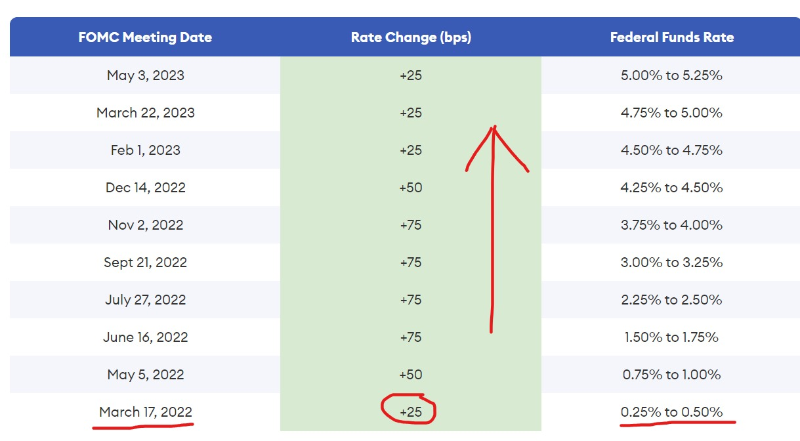
Us fed rate hikes

Slide 4
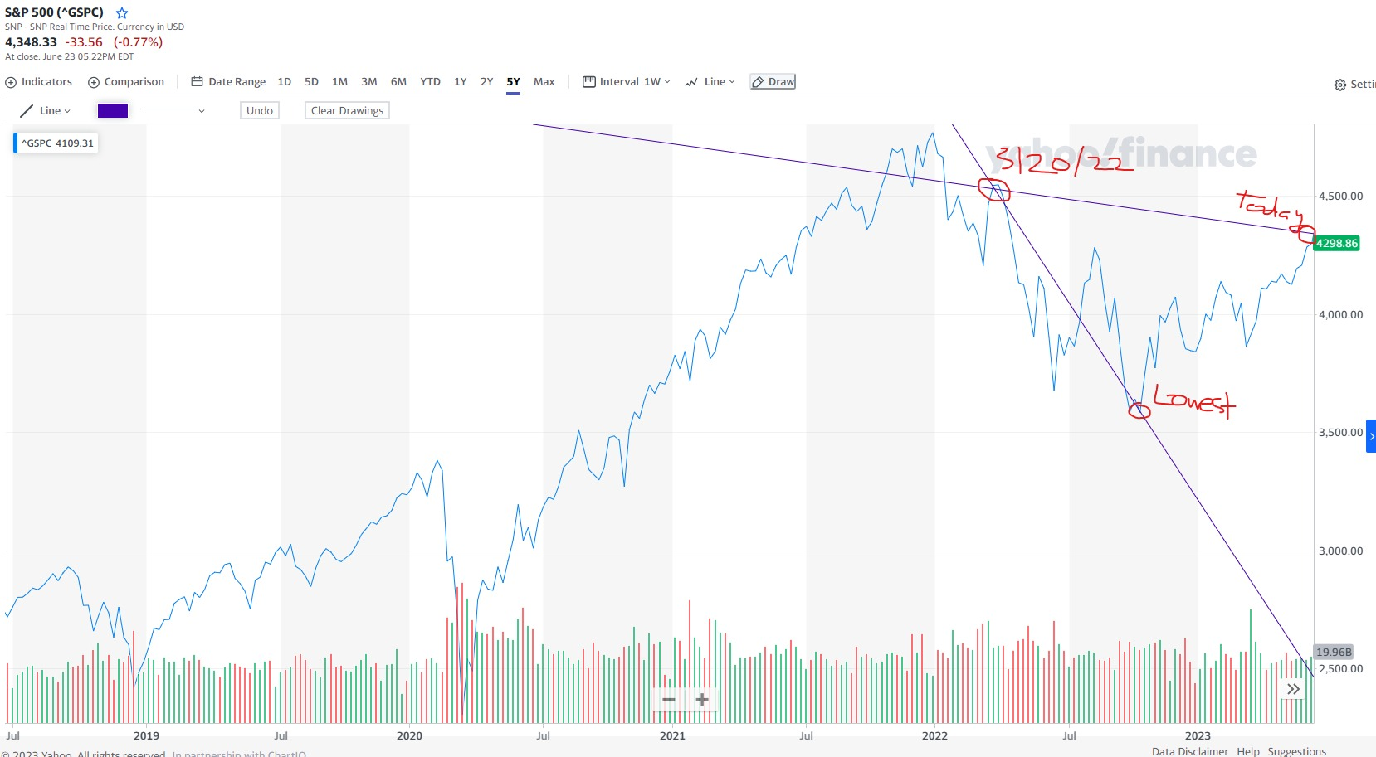
S&p 500 after the first hike

Slide 5
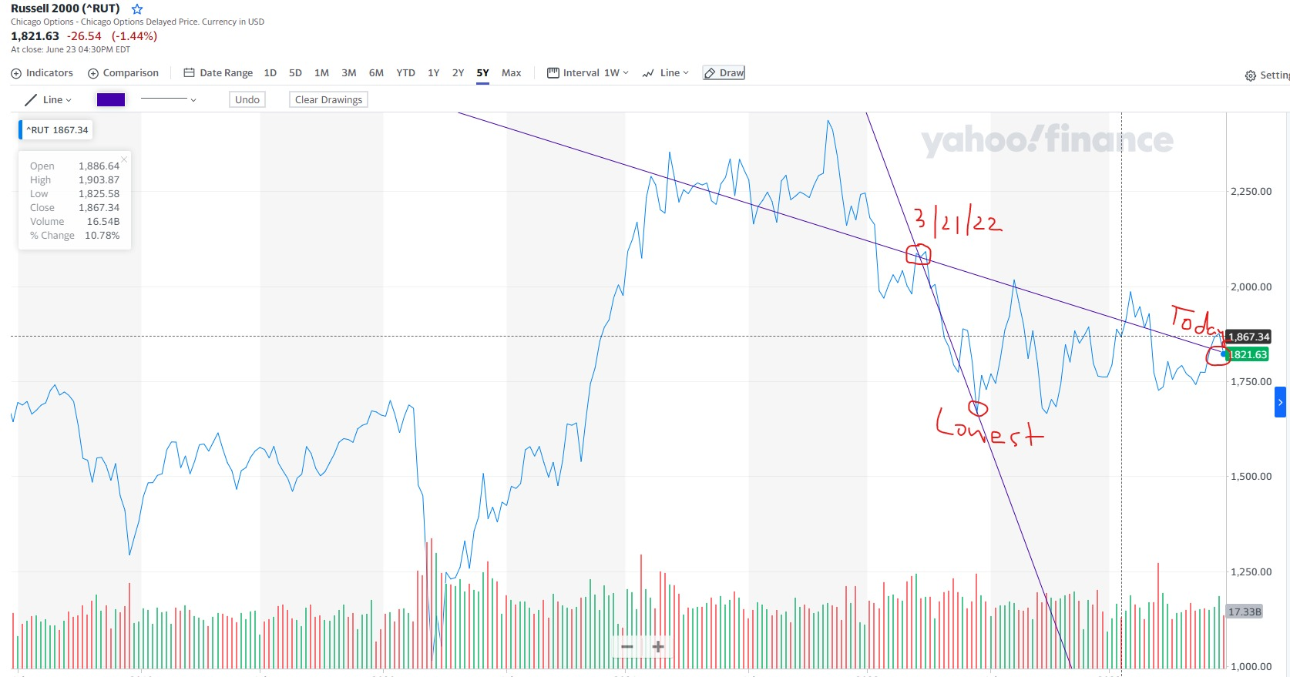
RUSSELL 2000 after the first hike

Slide 6
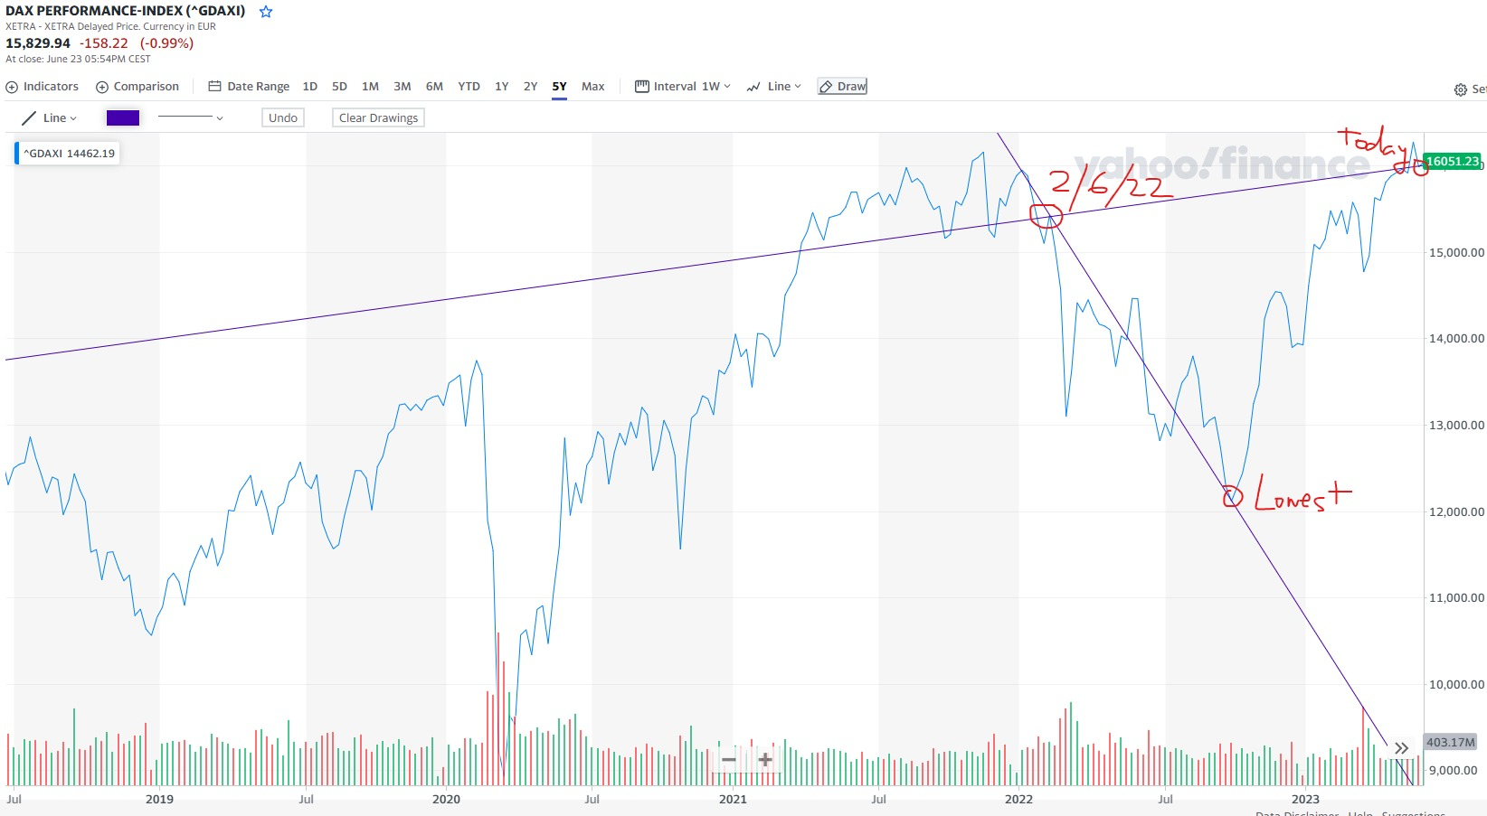
DAX (GERMANY) AFTER THE CONFLICT STARTED TO BECOME REAL

Slide 7
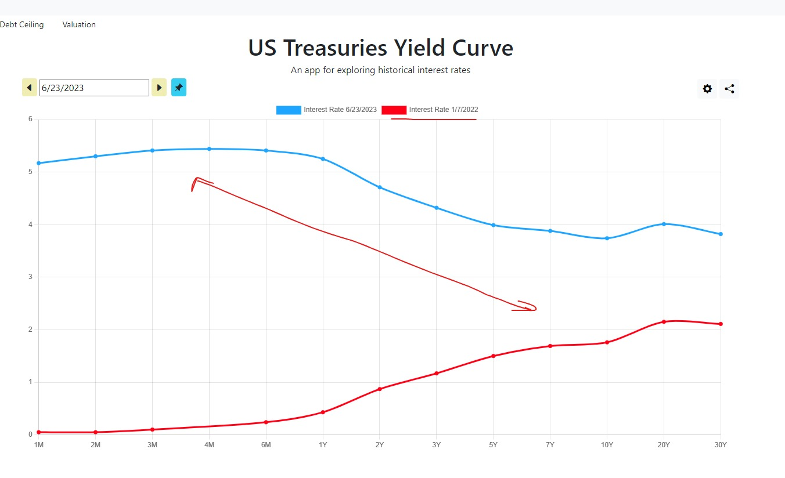
GOING BACK TO Jan. 2022…

Slide 8
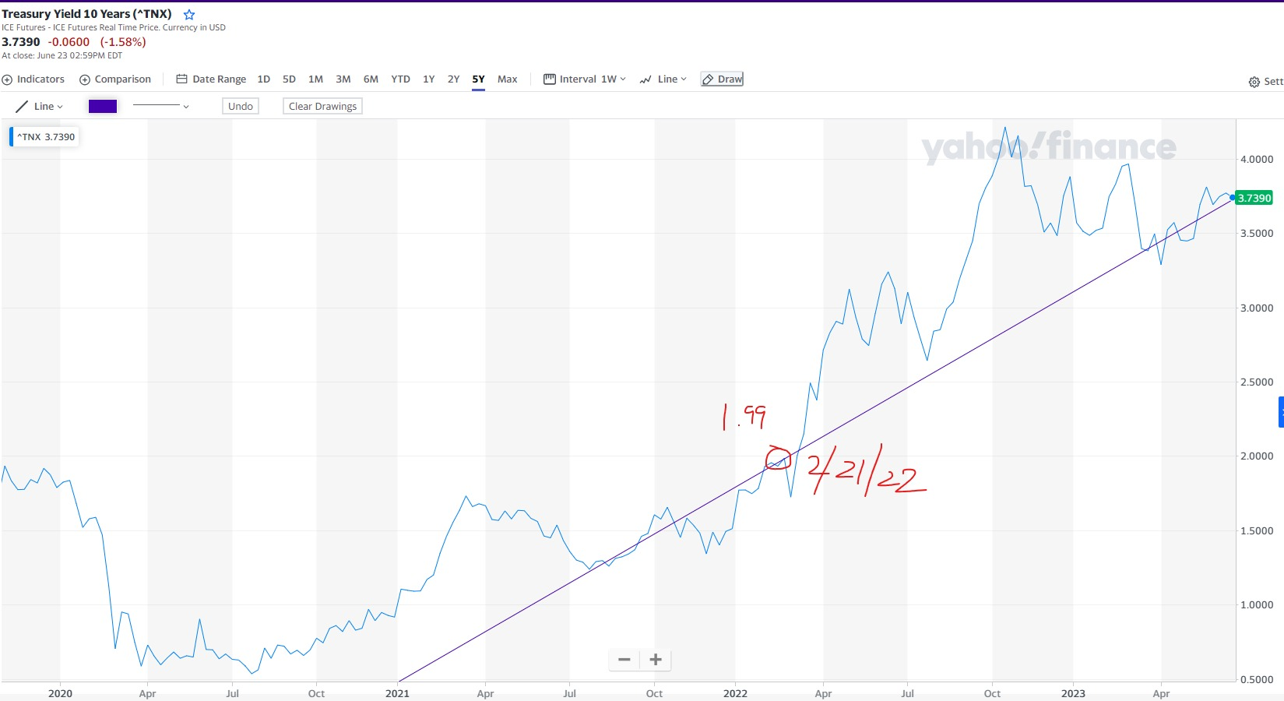
One of the craziest to me!

Slide 9
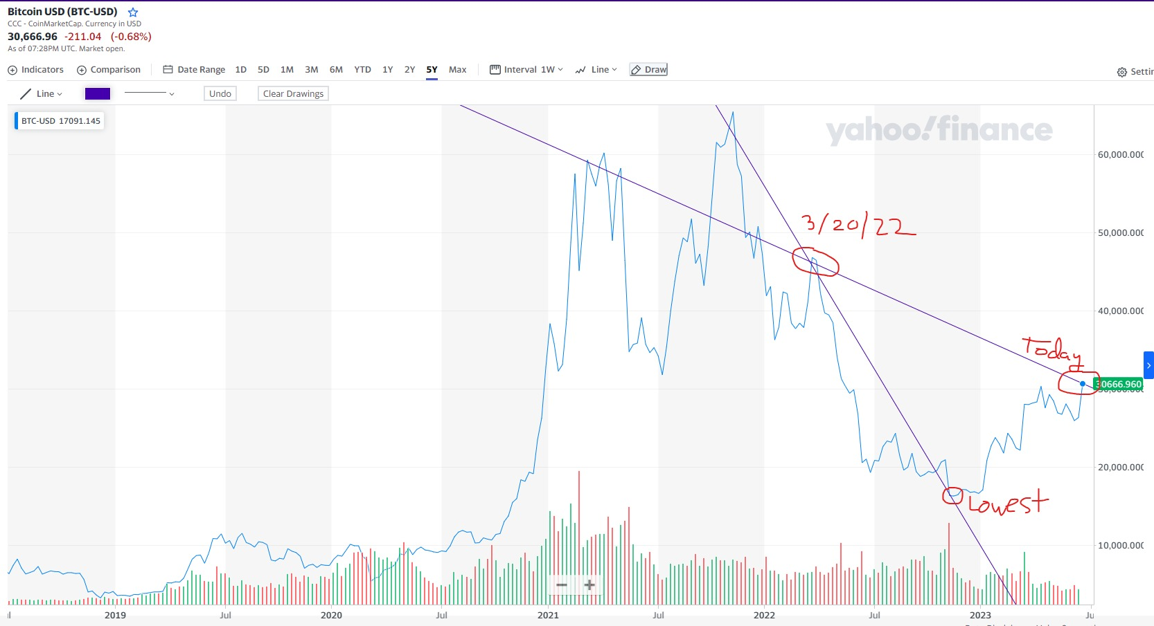
Btc…

Slide 10
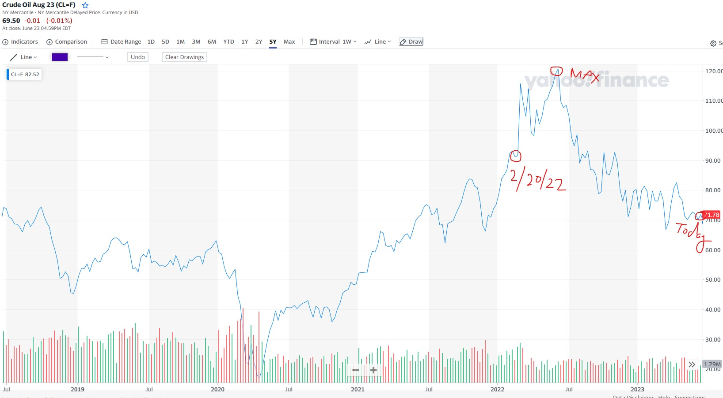
Crude oil volatility! (could be content for a whole new post…)

Slide 11
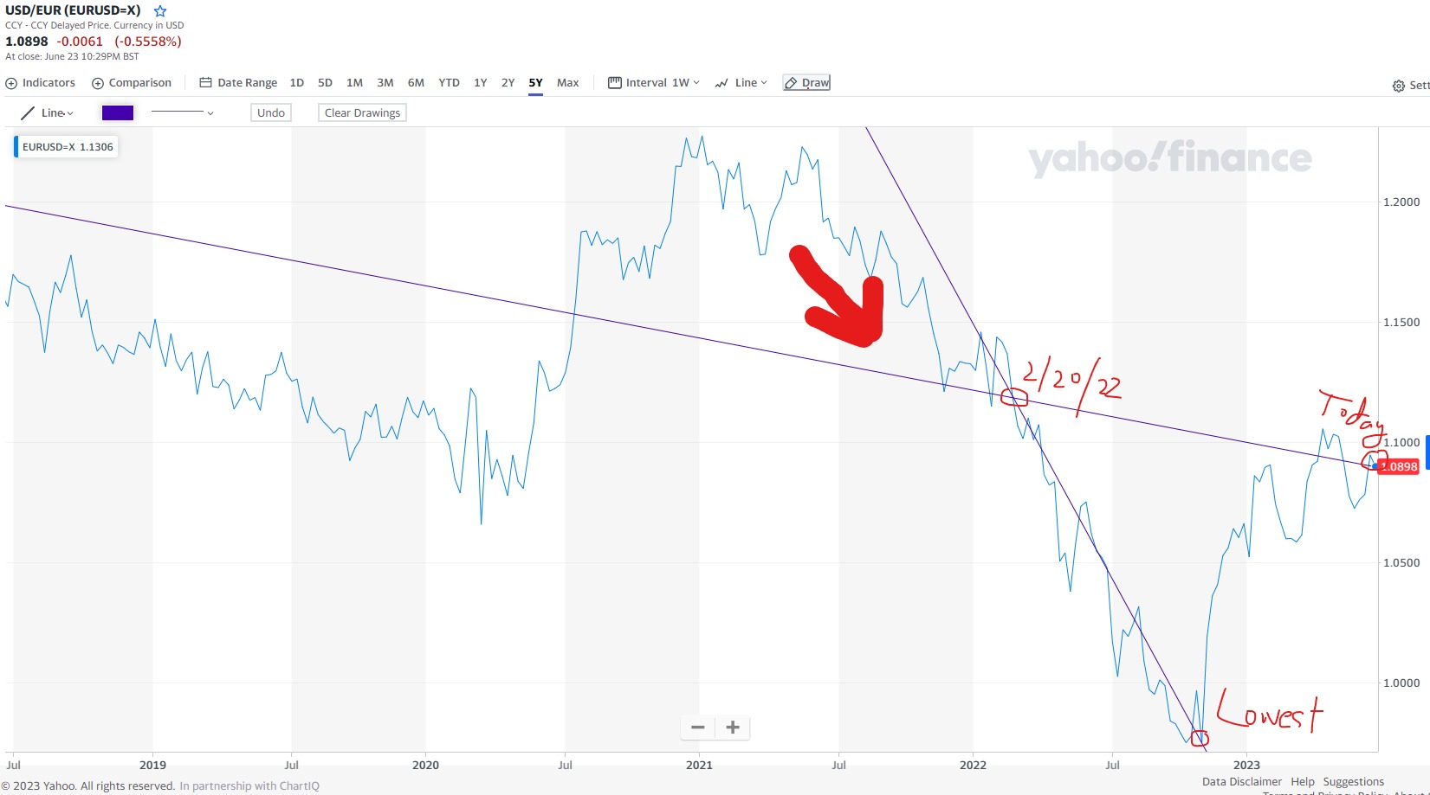
EURO STRUGGLES…

Slide 12
SO, WHAT?
We can observe how trendy assets like BTC were highly affected by these timelines. Indexes for almost every G7 stock market (showed the US and Germany), commodities such as crude oil, the most traded and exchanged currencies worldwide, US treasury yields... the list could go on and on, showing how the economies were affected. It is true, though, and as some of the graphs show, that nowadays in June 2023 we are in a much better overall situation. However, now that every news headline is focusing on Ukraine again, it is important to delve into the reasons why this conflict can be considered a significant X-factor and how the timing has influenced the past 16 months.

Slide 13
sources
Yahoo Finance
Bloomberg Terminal
Forbes

Slide 14

Where are we headed?

